Slide 1
Motivation
The Watson-Mastery approach to competency-based personalized learning appears to retain appeal in the marketplace.
Delivering the Watson-Mastery value proposition requires a digitized, aligned curriculum:
Proficiency specifications (learning standards and progressions);
Academic courses, instructional units specified in terms of the learning standards;
Students enrolled in aligned academic courses;
Periodic standards-aligned evidence of learning measured for enrolled students against in-scope learning standards; and
Policies, preferences for associating student/learning-standard measurements with proficiency levels.
We often discover curriculum misalignments only late during the delivery experience.
Characterizing the extent of curriculum-alignment at the beginning of the adoption process might pre-qualify clients.
Perhaps school-district leaders finding Watson-Mastery appealing find a curriculum-alignment assessment useful in its own right.
Decomposing Mastery implementation, resequencing the activities establishes expectations early, reduces later-stage risk.

Slide 2
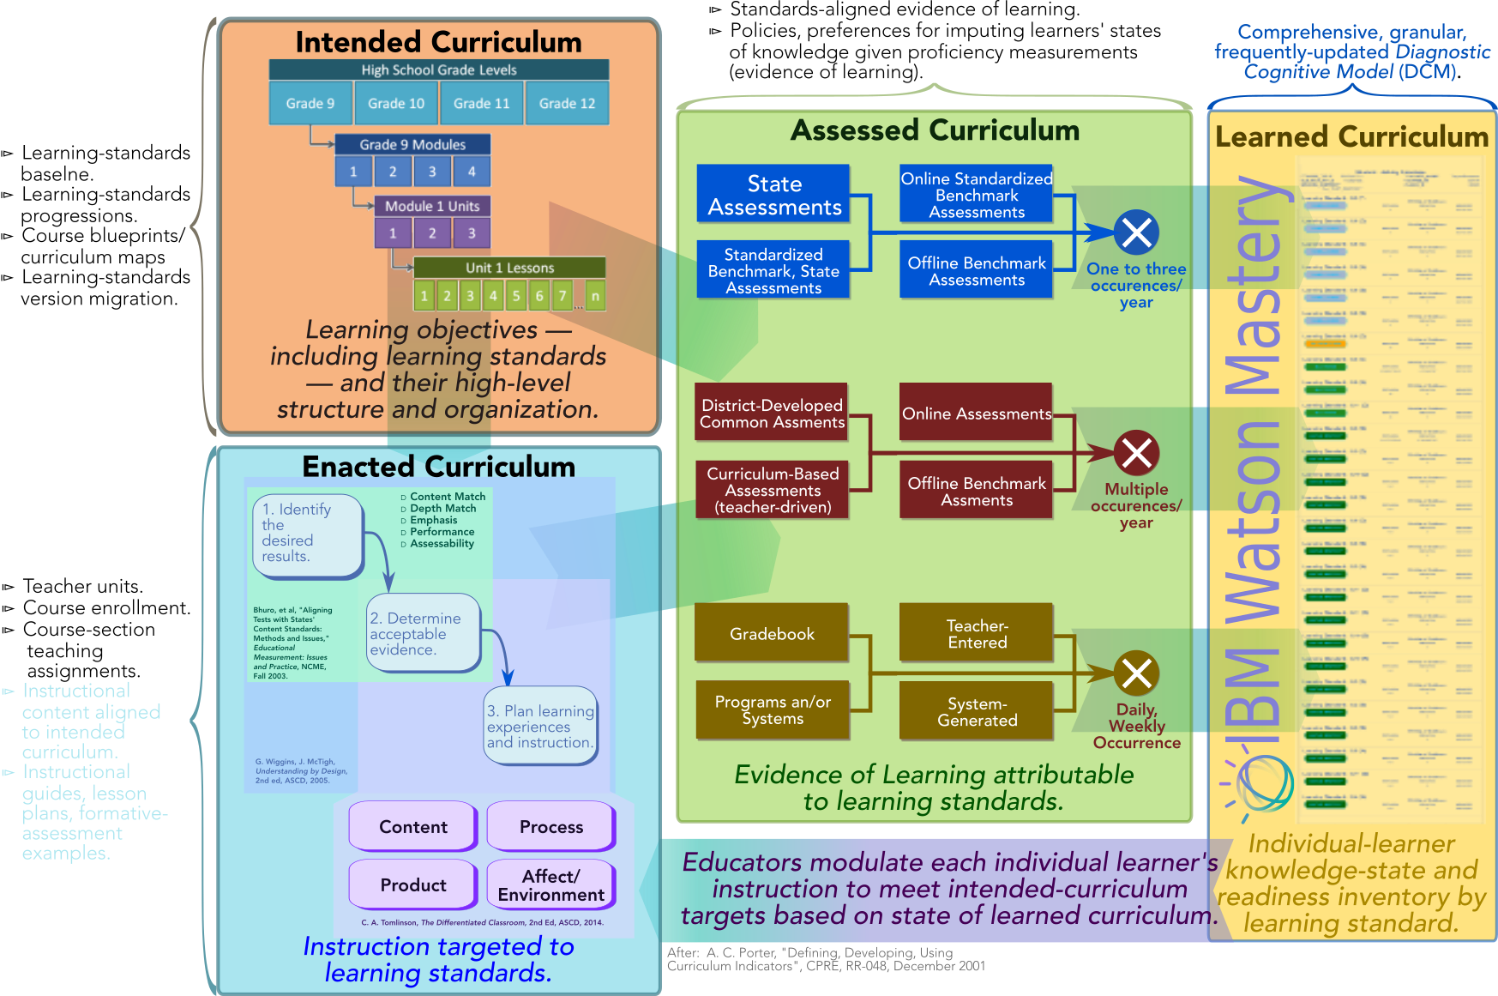
The education theory on which Watson-Education Mastery is based depends on an aligned, digitized curriculum.

Slide 3
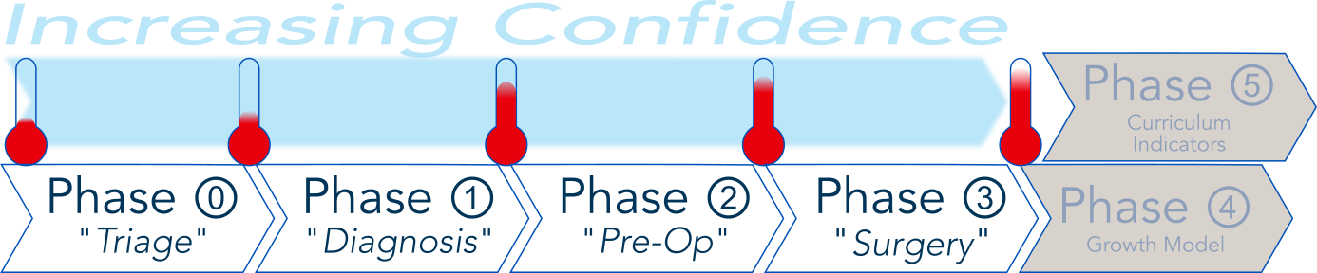
The Mastery-Adoption flow incrementally increases both clients’ and technology partners’ confidence prior to making a big commitment.
Mastery-Adoption Stage |  |  | Objectives and Outcomes
⓪ | Curriculum-digitization and -alignment survey. |  | Qualitative assessment of the degrees of alignment and digitization of prospective clients’ curriculum and assessments: Not basis for high confidence but screens out non-starters. Adoption-readiness recommendation based on template-driven maturity model. ”Physical audit” of factors in validation worksheet, including visual inspection of bases for each assertion. Recommended roadmap to digitize, improve alignment of curriculum and assessments. Go/no-go recommendation. Recommended actions to get from “No” to “Go”.
① | Curriculum-Alignment Analysis. |  | Quantitative “logical” indicators of extent of alignment of digitized curriculum and assessments based on actual client data. Detailed project plan — proposal-quality BoE — to fully operationalize Watson-Education Mastery.
② | ⓐ | Reusable logic to transform standards-aligned evidence of learning into Watson-Compatible format from unprecedented source. | Development, operationalization of data-transformation logic, interface to submit standards-aligned evidence of learning from unprecedented source (e.g., third-party system IBM hasn’t seen before). Map source-system learning-standard notation (codes) to Watson-recognized notation.
 | ⓑ | Configure logic to transform standards-aligned evidence of learning into Watson-Compatible format from precedented source. | Configure and check out existing logic. Map source-system learning-standard notation (codes) to Watson-recognized notation.
 | ⓒ | Digitize academic curriculum so that it can be machine-aligned by Watson. | Employ IBM tooling to capture instructional-unit/learning-standard structure of academic courses for Watson-supported learning-standard regime. Understand approach for, frequency of capturing of standards-aligned evidence or learning.
 | ⓓ | Digitize an unsupported learning-standards regime in Watson-compatible format. | Translate into Watson-compatible format learning standards and progressions.
③ | Operational initialization of Watson-Education Mastery. |  | Full operationalization of Watson-education Mastery.

Slide 4
The Mastery-Adoption flow incrementally increases both clients’ and technology partners’ confidence prior to making a big commitment.
Stage | IBM Effort (hours) | Client Effort (hours) | Condition
Stage ⓪ — Curriculum-Alignment Workshop Totals | 24 | 36
Stage ① — Curriculum-Alignment Indicators Study Totals | 74 | 36 | Heavy IBM Assist
Stage ① — Curriculum-Alignment Indicators Study Totals | 58 | 90 | Client DIY
Stage ②ⓐ — Develop Interface to Unprecedented Third-Party Source | 69 | 34 | Lower-bound IBM-effort scenario: ⧐ Simple structure to third-party extract. ⧐ Learning-standards cross-mapping by text-string manipulation.
Stage ②ⓐ — Develop Interface to Unprecedented Third-Party Source | 80 | 34 | Upper-bound IBM-effort scenario: ⧐ Complex structure to third-party extract. ⧐ Learning-standards cross-mapping by curriculum-management tool.
Stage ②ⓑ — Develop Interface to Precedented Third-Party Source | 55 | 27 | Lower-bound IBM-effort scenario: ⧐ Learning-standards cross-mapping by text-string manipulation.
Stage ②ⓑ — Develop Interface to Precedented Third-Party Source | 58 | 27 | Upper-bound IBM-effort scenario: ⧐ Learning-standards cross-mapping by text-string manipulation.
Stage ②ⓒ — Digitize Curriculum Totals | 30.5 | 24.5

Slide 5
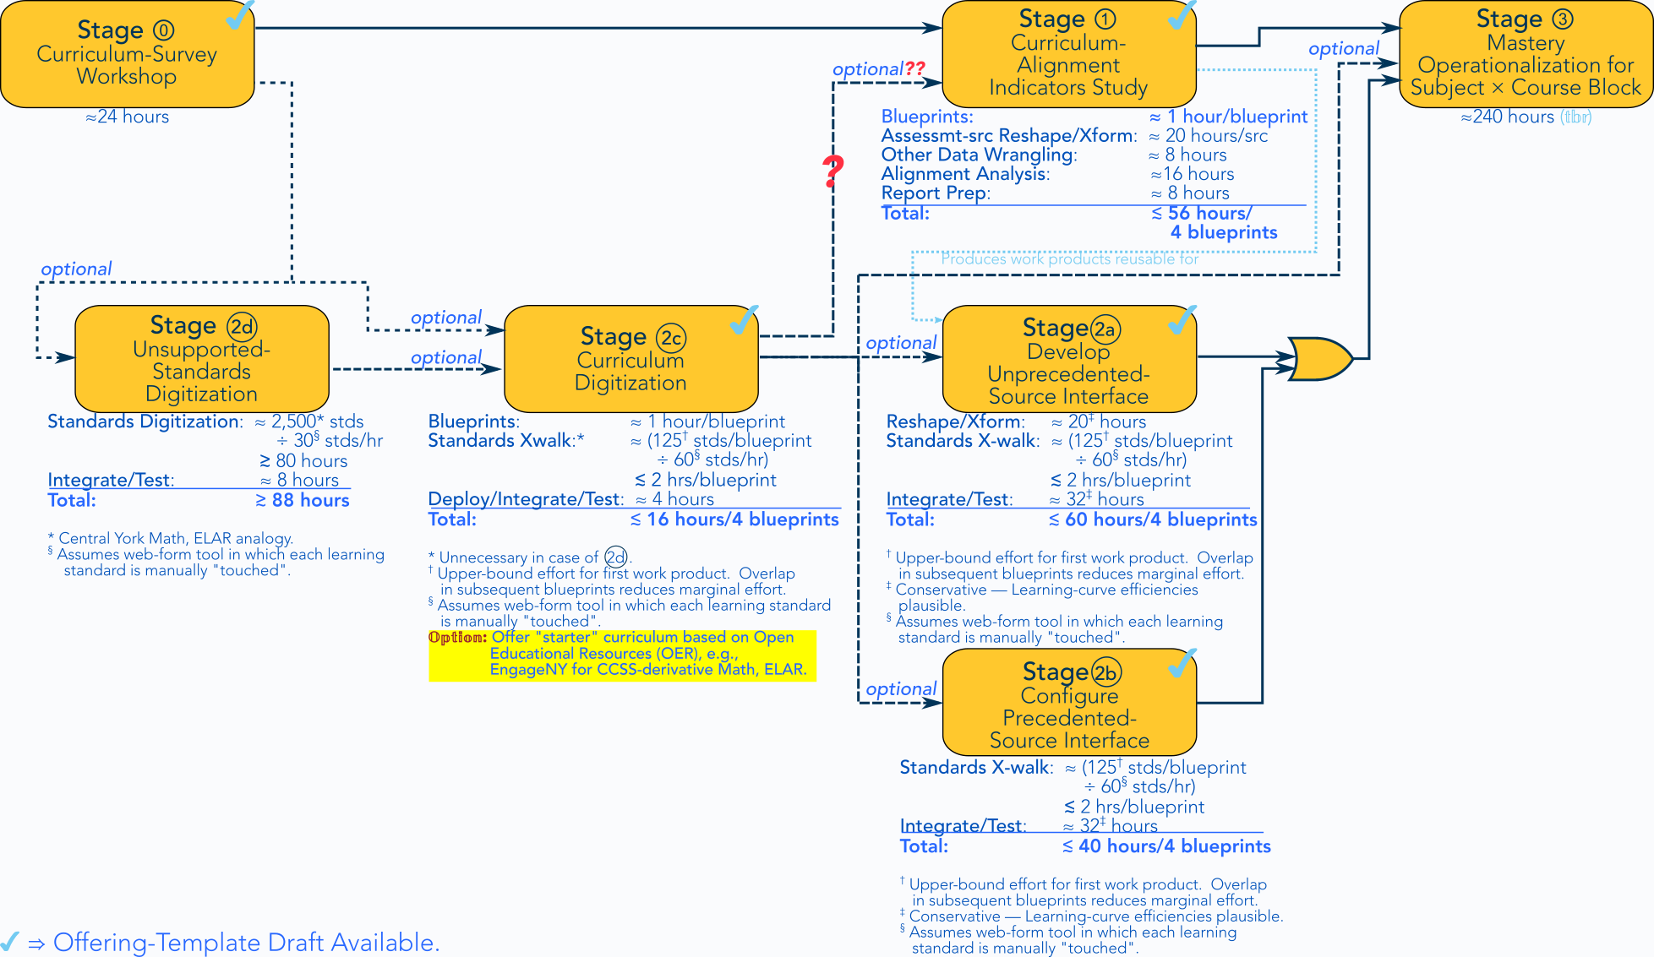
The offerings represent an interrelated set of tasks culminating in Mastery operationalization.

Slide 6
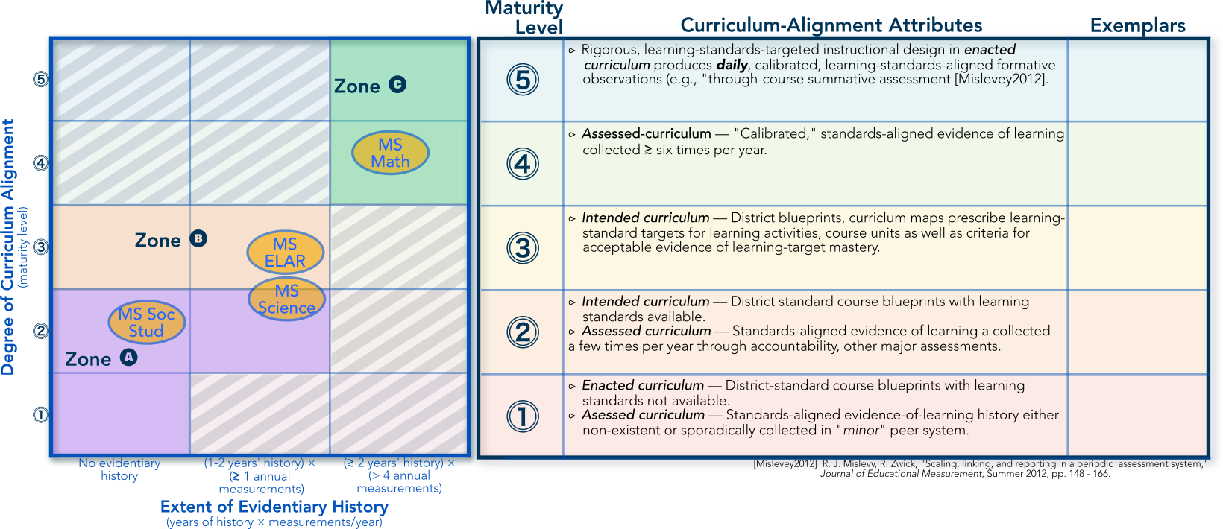


Phase ⓪ Client-Maturity analysis identifies clients unlikely to successfully adopt Watson Mastery without substantial work.

Slide 7
Phase ⓪: Client-qualification review ascertains state of client maturity, readiness to adopt Watson-Education Mastery.
Offering Name | Mastery Readiness — Curriculum-digitization and -alignment workshop survey.
Objectives: | Introduced Watson-Education framework for curriculum digitization and alignment, prerequisite for scalable competency-based differentiated instruction, personalized learning.
 | Learning standards and progressions; Intended curriculum (course blueprints, curriculum maps, etc); Enrolled students and teacher assignments; |  |  |  | Standards-aligned evidence of learning; and Consistent criteria for associating evidentiary observations with proficiency/mastery states.
 | Perform qualitative, template-driven alignment analysis based on readily-available curriculum, assessment artifact. Provide readiness assessment using staged maturity model.
Approach: | Begin with template capturing curriculum scope (subject × grade level × campus). Review exemplary curriculum artifacts based on alignment, digitization criteria. Curriculum maps, course blueprints, scope & sequence, etc. Instructional guides, rubrics, formative-assessment examples and guidelines. Interim/summative assessments. |  |  |  | Review assessments plan to understand approach to, frequency of standards-aligned evidence of learning. Apply rubrics/heuristics to associate distinct grades, subjects with maturity-model stages. Synopsize results. Sketch out roadmap to advance state of curriculum digitization, alignment.
Deliverables: | Final review in PowerPoint format, including: ⧐ Qualitative assessment of the degrees of alignment and digitization of prospective clients’ curriculum and assessments; ⧐ Adoption-readiness recommendation based on template-driven maturity model; and ⧐ Recommended roadmap to digitize, improve alignment of curriculum and assessments.
Engagement Duration: |  | 3 weeks | IBM Effort: | 24 hours | 32 hours | Est Client Effort: | 36 hours

Slide 8
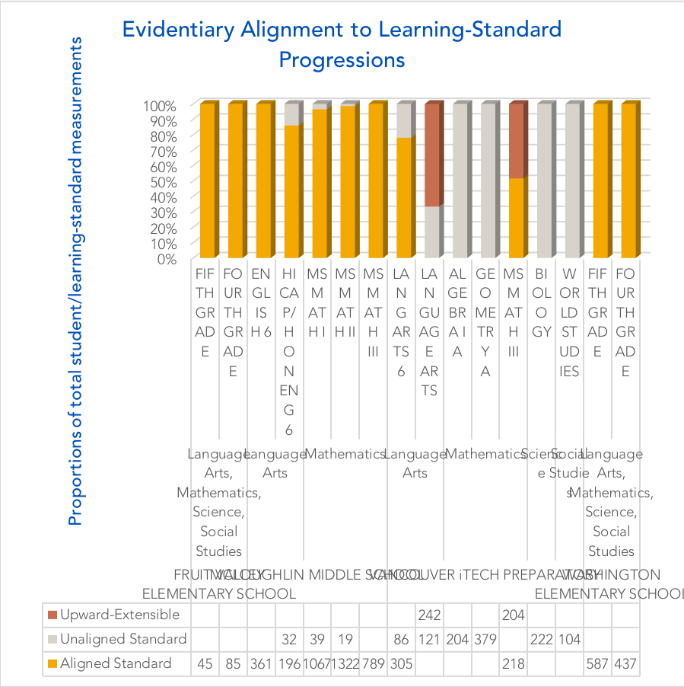
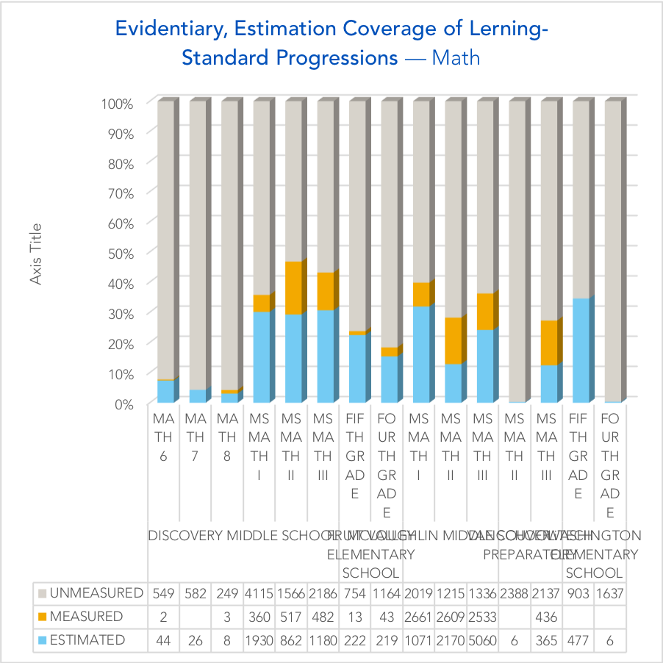

Phase ① analysis provides quantitative, evidence-based confidence on both sides of transaction to make the investment.
Alignment analysis answers questions like, “Is the system measuring what is specified by curriculum policy?”
Coverage analysis answers questions like, “Is the system covering everything our policy specifies should be covered?”

Slide 9
Phase ① curriculum-alignment analysis empirically demonstrates clients’ readiness to adopt Watson-Education Mastery.
Offering Name: | Alignment indicators analysis for digitized curriculum.
Objectives: | Engender sufficient confidence on both sides to take commit to the investment of Watson-Education Mastery implementation. Acquaint prospective client with mechanics of curriculum-digitization and -alignment. Develop detailed mastery-implementation plan (proposal-quality Basis of Estimate).
Approach: | Specify scope limited to academic-course “block” defined by one subject × four courses (at most). Collect actual digitized-curriculum data from client. IBM digitizes “intended” curriculum (course blueprints, curriculum maps using Watson-Education Curriculum Tool (≳ 1.5 hrs/course × 6 courses ≳ 9 hrs client). Client provides 𝕤𝕚𝕞𝕡𝕝𝕚𝕗𝕚𝕖𝕕 SIS-extract student-course enrollment data for intended scope analysis (6 hrs client). Client provides standardized-aligned evidence of learning in structured, digitized format (12 hrs client). Client employs learning-standard mapping tool to associate learning standards (200 stds ÷ ≳15 stds/hr ≳ 12 hrs client). IBM performs curriculum-alignment analysis. (Tooling initially SQL+python, excel pivot tables.) (≳ 20 hrs)
 | Blueprints ↔︎ learning-standard progressions. Evidence of learning ↔︎ course blueprints. |  | Evidence of learning ↔︎ learning-standards progressions. Likely evidentiary, estimation coverage.
 | Review assessments plan to understand approach to, frequency of standards-aligned evidence of learning (1 hr IBM, 3 hrs client). Deliver report graphically depicting curriculum-alignment indicators (1½ hrs IBM, 6 hrs client). Update maturity assessment (2 hrs IBM, 4 hrs client review). 𝕆𝕡𝕥𝕚𝕠𝕟𝕤: ⓐ Client provides standards-aligned evidence of learning in source-system "native" format for 𝕠𝕟𝕖 assessments system. IBM expends 12 hours for ad-hoc "data-wrangling" to render in Watson-compliant format, including learning-standards mapping. ⓑ Client employs to-be-developed tool to map columns from source-system-extract to Watson-table columns (reduce 2a, 2c by 6 hrs both).
Deliverables: | Final report including PowerPoint, Excel artifacts including: ⧐ Quantitative “logical” indicators of extent of alignment of digitized curriculum and assessments based on actual client data; and ⧐ Detailed project plan — proposal-quality BoE — to fully operationalize Watson-Education Mastery.
Assumptions: | ⓵ Data and privacy agreement in effect for sharing data. |  | ⓶ Client’s curriculum aligned to Watson-supported learning-standards set.
Engagement Duration: 4 Weeks |  | Est IBM Effort: 74 hours |  | Est: Client Effort: 36 hours

Slide 10
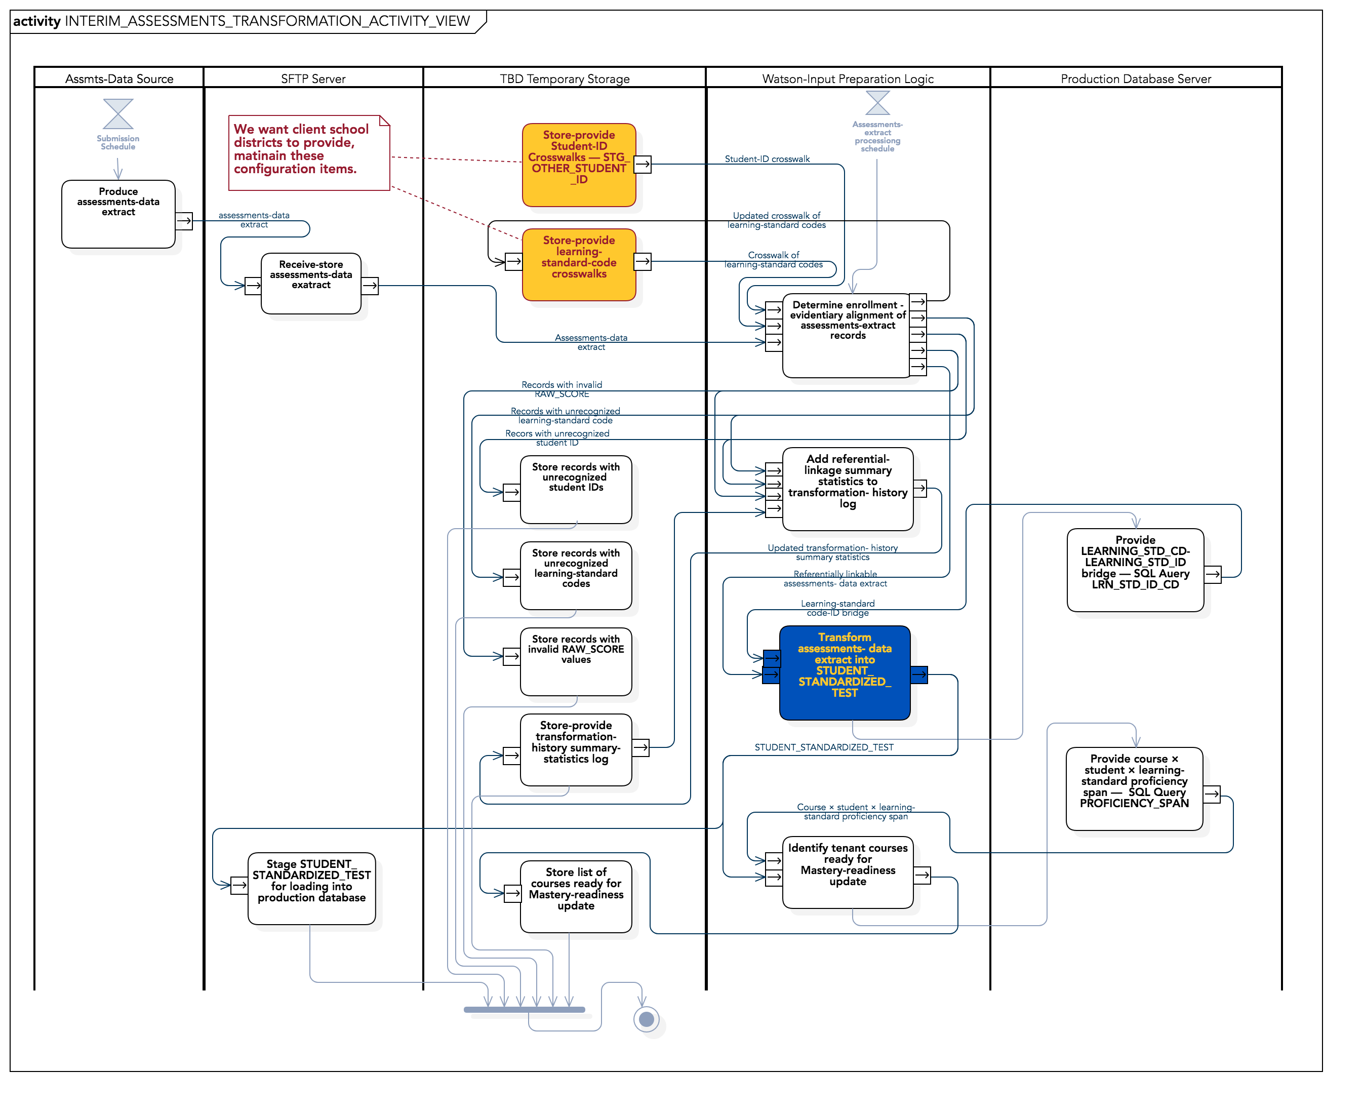

Phase ②ⓐ, ⓑ implements or configures interface between third-party standards-aligned assessment system and Watson-Education.
Scope concentrated on separable set of functional software configuration items.
To Be Revised

Slide 11
Phase ⓶ⓐ extends Watson-Education’s assessments-data integration to not-previously-encountered third-party vendors.
Offering Name: | ⓐ Assessments-data integration — unprecedented source.
Objectives: | Reusable logic to transform standards-aligned evidence of learning into Watson-Compatible format from unprecedented source.
Approach: | Work into existing assessments-data-integration framework. ⓵ Client provides cross-walk for learning-standard codes to map to Watson format (learning-standard cross-walk tool?). ⓶ Client provides cross-mapping for student id between enrollment (SIS) and assessments system (if necessary). ⓷ In consultation with 3ʳᵈ-party provider or client, IBM produces new logic to reshape system output, map to Watson-Mastery table specifications. ⓸ IBM integrates conversion logic into Watson-Education data-ingestion framework. 𝕆𝕡𝕥𝕚𝕠𝕟: ⓐ IBM performs learning-standard-code cross-mapping (16 hours additional effort). ⓑ Client employs to-be-developed tool to map columns from source-system-extract to Watson-table columns.
Deliverables: | ⧐ Functional demonstration of production-ready data-conversion logic for assessments-data source.
Assumptions: | ⓵ Client mediates relationship with 3ʳᵈ-party provider to provide IBM with access. ⓶ Third-party provider willing to play. ⓷ Third-party provider agrees to short list of SLAs (frequency, conformity, etc.). |  |  | ⓸ Measurements are recorded in Watson-Mastery-Supported fashion (pre-weighted cumulative or independent measurements) ⓹ Third-party system provides measurements aligned to digitized curriculum (verified by alignment indicators).
Engagement Duration: |  | 3 weeks | Est IBM Effort: | 80 hours | Est: Client Effort: | 34 hours

Slide 12
Phase ⓶ⓑ extends Watson-Education’s assessments-data integration to previously-encountered third-party vendors.
Offering Name: | ⓑ Assessments-data integration — precedented source.
Objectives: | Configure logic to transform standards-aligned evidence of learning into Watson-Compatible format from precedented source.
Approach: | Work into existing assessments-data-integration framework. ⓵ Client provides cross-walk for learning-standard codes to map to Watson format (learning-standard cross-walk tool?). ⓶ Client provides cross-mapping for student id between enrollment (SIS) and assessments system (if necessary). ⓷ Use existing logic to reshape system output, map 3ʳᵈ-party provider or client to Watson-Mastery table specifications. ⓸ IBM configures existing conversion logic into Watson-Education data-ingestion framework. 𝕆𝕡𝕥𝕚𝕠𝕟: ⓐ IBM performs learning-standard-code cross-mapping (16 hours additional effort).
Deliverables: | ⧐ Functional demonstration of production-ready data-conversion logic for assessments-data source.
Assumptions: | ⓵ Client mediates relationship with 3ʳᵈ-party provider to provide IBM with access. ⓶ Third-party provider willing to play. ⓷ Third-party provider agrees to short list of SLAs (frequency, conformity, etc.). |  |  | ⓸ Measurements are recorded in Watson-Mastery-Supported fashion (pre-weighted cumulative or independent measurements) ⓹ Third-party system provides measurements aligned to digitized curriculum (verified by alignment indicators).
Engagement Duration: |  | 3 weeks | Est IBM Effort: | 60 hours | Est: Client Effort: | 27 hours

Slide 13
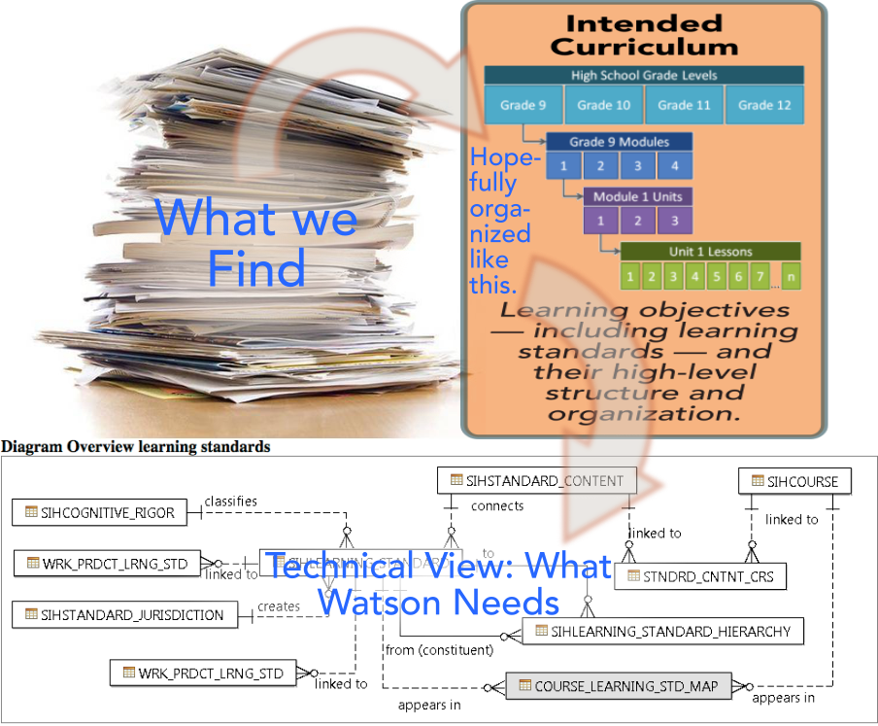
Phase ②ⓒ, ⓓ translates the client’s curriculum — such as it is — into a structured, digitized framework needed for Watson Mastery’s Diagnostic Cognitive Model.
This Graphic To Be Revised

Slide 14
Phase ⓶ⓒ Digitizes the client’s curriculum into a Watson-compatible framework.
Offering Name: | ⓒ Curriculum digitization.
Objectives: | Digitize academic curriculum so that it can be machine-aligned by Watson.
Approach: | ⓵ Bound scope to single-subject block of four standard-grade-level courses (limited to six distinct course blueprints). ⓶ Review client’s curriculum-baseline specifications (course blueprints, curriculum maps, scope & sequence, etc.) and consult for understanding. ⓷ IBMer (or partner) employs curriculum-management tool to enter the curriculum. ⓸ Review plan for, frequency of collection of standards-aligned evidence of learning for in-scope courses.
Deliverables: | ⧐ Load-ready Watson-conforming tables representing instructional-unit/learning-structure of in-scope courses delivered in (comma-separated variable (csv) (TBR) Watson-conforming format.
Assumptions: | ⓵ Client employs Watson-supported learning-standard regime (e.g., one that we get from Edgate, etc.). ⓶ Client employs relatively-centralized curriculum-governance practices: Relative uniformity at subject × grade-level throughout system. |  |  |  | ⓷ Client-organization curriculum authorities have documented and published instructional-unit/learning-standard scope for in-scope instructional courses. ⓸ Systems, plan exists for collection of standards-aligned evidence of learning at a frequency of not less than eight times during academic year for in-scope courses.
 | 𝕆𝕡𝕥𝕚𝕠𝕟: ⓐ IBM gives client a “starter” curriculum curriculum based on Open Educational Resource (OER) patterns, e.g., EngageNY.
Engagement Duration: |  | 3 weeks | Est IBM Effort: | 30 hours/4 blueprintss | 24 hours | Est: Client Effort: | 24 hours

Slide 15
Phase ⓶ⓓ Digitize unsupported learning-standard regime (e.g., substantial deviation from commonly available state learning standards).
To be Revised
Offering Name: | ⓓ Curriculum digitization.
Objectives: | Digitize an unsupported learning-standards regime in Watson-compatible format.
Approach: | ⓵ Bound scope to single-subject block of four standard-grade-level courses (limited to six distinct course blueprints). ⓶ Carefully review the learning standards with the client to understand their structure and content. ⓷ IBMer (or partner) employs 𝕥𝕠-𝕓𝕖-𝕕𝕖𝕧𝕖𝕝𝕠𝕡𝕖𝕕 tool to capture the learning standards, their structure, and their progressions.. ⓸ IBMer (or partner) produces load-ready, conforming tables for learning standards and progressions.
Deliverables: | ⧐ Load-ready Watson-conforming tables for learning standards.
Assumptions: | ⓵ Client’s learning-standard baseline spans the instructional scope for all in-scope courses: It’s what they 𝕣𝕖𝕒𝕝𝕝𝕪 teach and measure. ⓶ Client employs relatively centralized curriculum-governance approach: consistent use of learning standards throughout system. ⓷ Client employs assessments framework providing frequent (≳ eight times/academic year) evidence-of-learning measurements against this learning-standard baseline. |  |  | ⓸ The learning-standards framework conforms to certain 𝕥𝕠-𝕓𝕖-𝕤𝕡𝕖𝕔𝕚𝕗𝕚𝕖𝕕 technical/structural criteria. ⓹ The client has developed vertical articulations (aka progressions) of the learning standards representing how they build upon each other. These articulations span the in-scope block of courses, as well as the key prerequisites for the earliest course in the block.
Engagement Duration: |  | 4 weeks | Est IBM Effort: | 96 hours | Est: Client Effort: | 60 hours

Slide 16
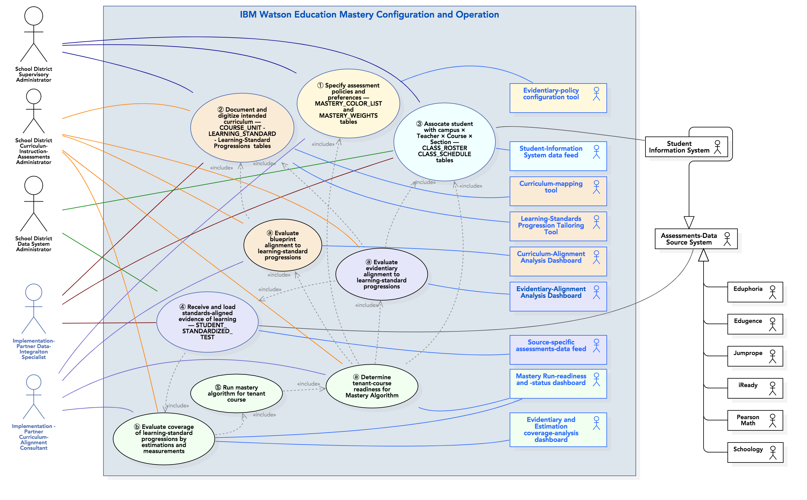

Phase ③ operationalizes Watson-Education mastery in the client’s education-technology ecosystem.

Slide 17
Phase ⓷ configures Watson-Education Mastery to operate with the client’s aligned, digitized curriculum.
To be Revised
Offering Name: | Assessments-data integration
Objectives: | Assist the client to realize fully operational Mastery based on digitized, aligned curriculum.
Approach: | ⧐ Build upon, extend work products work products generated during alignment-indicators, ⧐ Specify scope in terms of one subject × four learning-standards grade-level block of academic courses.
Deliverables: | Scope of work graphically outlined in https://ibm.box.com/s/o5xoryfhdopo648r3wo8s9qdznlcwj4m
 | ⧐ Joint project plan for Mastery initialization. ⧐ Data-interface specification for 𝕞𝕚𝕟𝕚𝕞𝕦𝕞 data set — student course-section enrollment, teacher assignment, etc. — required for mastery operation. ⧐ Physical and logical configuration of Watson Education cloud meeting FERPA requirements for client. |  |  |  | ⧐ Configuration and access to Watson Education curriculum manager to digitize curriculum in Watson-conformable format. ⧐ Access to data-validation dashboarding for enrollment, assessments data. ⧐ Curriculum-alignment and -coverage indicators providing insight into breadth, depth of Mastery penetration into system. ⧐ "Go-live" event based on user-acceptance test.
Assumptions: | ⓵ Client sufficiently possesses digitized, aligned curriculum with assessments framework to derive benefit (verified by alignment indicators). ⓶ Client/partner possess data-preparation skills. ⓷ Solutions exist for automated data ingestion from essential third-party sources. |  |  |  | ⓸ Client employs Watson Curric-Mgt Tool to digitize curriculum (courses, instructional units, learning standards) in Watson-conforming format. (30 minutes/course × 6 courses/subject × 1 subjects ≈ 3 hrs) ⓹ Curriculum (proficiency specifications) in terms of generally available state learning standards (Common Core, TEKS, etc.).
 | 𝕋𝕆 𝔻𝕆: Deconvolve this workstream with data workstream.
Engagement Duration: |  | 90 days | Est IBM Effort: | 240 hours | 240 hours | Est: Client Effort: | 180 hours

Slide 18
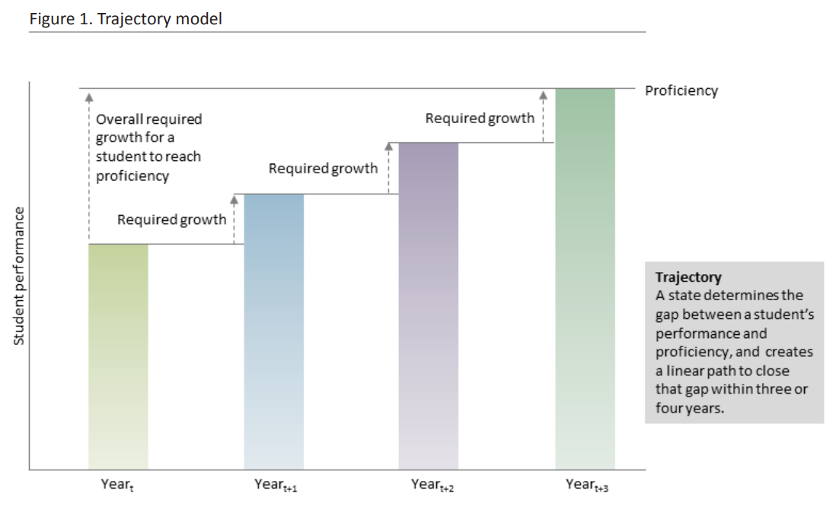
Phase ④ growth-model analysis gives educators, parents, other stakeholders a much-clearer view of individual-student progress than models based on state-accountability exams.
State-accountability exams severely under-sample “proficiency space” (http://ibm.biz/RSS-Significance-TestEfficiency).
Robustly implemented, Watson-Education Mastery collects provides relatively complete coverage.
From : “Growth models: Issues and advice from states,” U.S. Department of Education, https://nces.ed.gov/programs/slds/pdf/guide_growth-model.pdf.

Slide 19
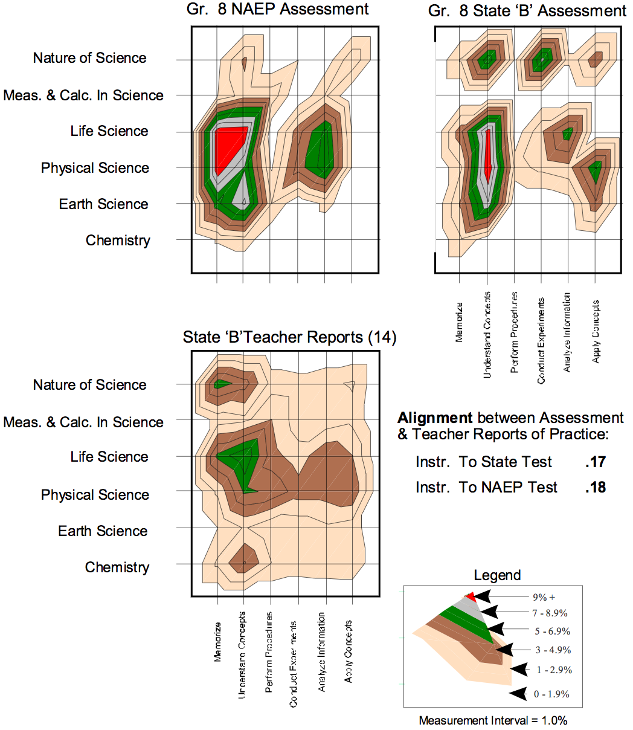
Phase ⑤ “advanced” curriculum-alignment indicators provide a sophisticated view of how what is being taught, measured addresses what is specified.
Phase ② curriculum-alignment administrators provide only a “binary” view of whether ”dots” — whether what is taught, measured addresses curriculum policy — are connected.
“Advanced” curriculum-alignment indicators provide supervisory, curriculum administrators with deeper insights into the extent to which their system uniformly provides opportunity to learn for all students.
From : A. Porter, “Defining, developing, and using curriculum indicators,” Center for Policy Research in Education (CPRE), University of Pennsylvania, December 2001, http://ibm.biz/PorterCurriculumAlignment.

